Slide 1
Profit Analysis using Regression & Data Visualization

Slide 2
Project Objective
Extract company data from the database.
Analyze the impact of R&D Spend, Administration, and Marketing Spend on Profit.
Predict Profit for given inputs using Regression Model.
Visualize insights using Tableau / Power BI.
Suggest strategies for better decision-making.

Slide 3
Dataset Overview
Data Source: Company’s Startup Dataset (50 entries)
Key Variables:
R&D Spend (Investment in research and development)
Administration (Operational management cost)
Marketing Spend (Advertising & promotion cost)
Profit (Target variable)
Data pulled from MySQL Database into local environment.

Slide 4
Data Preprocessing
Checked for missing/null values → None.
Identified and treated outliers in Profit column.
Normalized/cleaned data for model building.
Split data into Training (70%) and Testing (30%) sets.

Slide 5

Regression Analysis
Method: Multiple Linear Regression
Equation:
Y=m1x1+m2x2+m3x3+c
$Profit=m1\left(R\&D Spend\right)+m2\left(Administration\right)+m3\left(Marketing Spend\right)+c$

Slide 6
Model Evaluation:
R² Score: 0.91195
Co-efficients:
m1→0.7447
m2→-0.144
m3→0.0218
P-values for predictors :
R&D Spend -----------→ 0.000000003 (Highly significant)
Administration -------→ 0.8225 (Not significant)
Marketing Spend ----→ 0.2942 (slightly significant)
Key Insight: R&D Spend has the highest positive impact on Profit

Slide 7
Prediction Results
Input Features & Predicted Profits:
R&D Spend | Administration | Marketing Spend | Predicted Profit
21892.92 | 81910.77 | 164270.70 | 74897.244
23940.93 | 96489.63 | 137001.10 | 75617.984

Slide 8
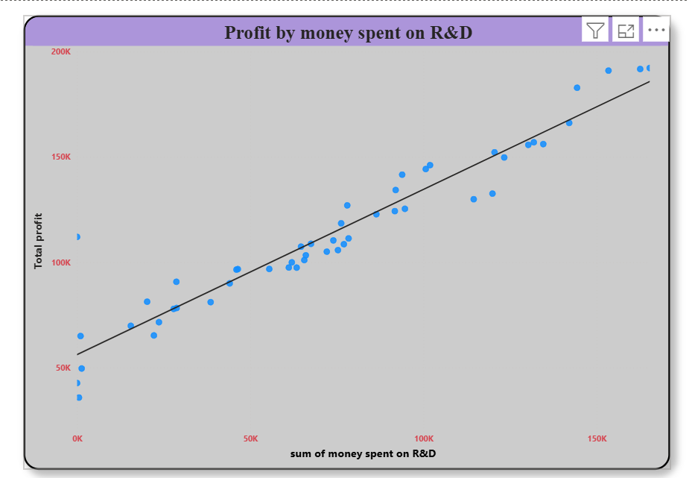
R&D Spend vs Profit
Sum of RD_Spend | Profit
542.05 | 35673.41
0 | 42559.73
1315.46 | 49490.75
1000.23 | 64926.08
22177.74 | 65200.33
15505.73 | 69758.98
23640.93 | 71498.49
27892.92 | 77798.83
28754.33 | 78239.91
38558.51 | 81005.76
20229.59 | 81229.06
44069.95 | 89949.14
28663.76 | 90708.19
46014.02 | 96479.51
46426.07 | 96712.8
55493.95 | 96778.92
63408.86 | 97427.84
61136.38 | 97483.56
61994.48 | 99937.59
65605.48 | 101004.64
66051.52 | 103282.38
72107.6 | 105008.31
75328.87 | 105733.54
64664.71 | 107404.34
77044.01 | 108552.04
67532.53 | 108733.99
73994.56 | 110352.25
78389.47 | 111313.02
0 | 112012.6
76253.86 | 118474.03
86419.7 | 122776.86
91749.16 | 124266.9
94657.16 | 125370.37
78013.11 | 126992.93
114523.61 | 129917.04
119943.24 | 132602.65
91992.39 | 134307.35
93863.75 | 141585.52
100671.96 | 144259.4
101913.08 | 146121.95
123334.88 | 149759.96
120542.52 | 152211.77
130298.13 | 155752.6
134615.46 | 156122.51
131876.9 | 156991.12
142107.34 | 166187.94
144372.41 | 182901.99
153441.51 | 191050.39
162597.7 | 191792.06
165349.2 | 192261.83

Slide 9
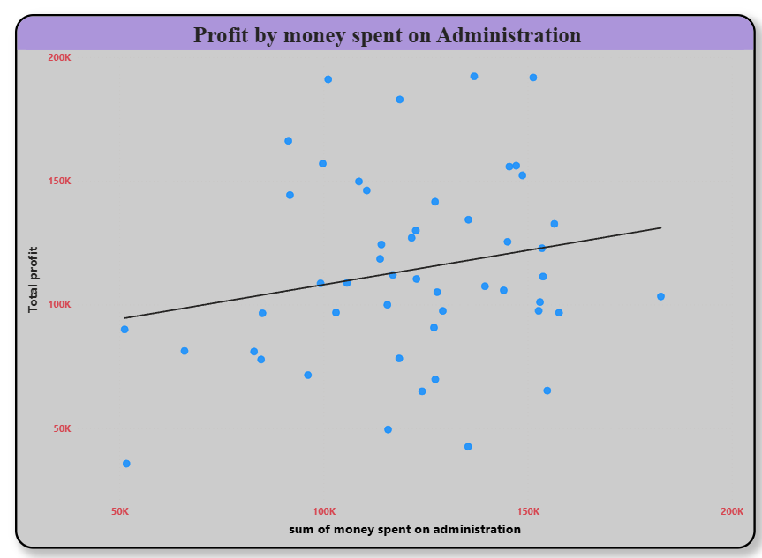
Administration Vs Profit
Sum of Administration | Profit
51743.15 | 35673.41
135426.92 | 42559.73
115816.21 | 49490.75
124153.04 | 64926.08
154806.14 | 65200.33
127382.3 | 69758.98
96189.63 | 71498.49
84710.77 | 77798.83
118546.05 | 78239.91
82982.09 | 81005.76
65947.93 | 81229.06
51283.14 | 89949.14
127056.21 | 90708.19
85047.44 | 96479.51
157693.92 | 96712.8
103057.49 | 96778.92
129219.61 | 97427.84
152701.92 | 97483.56
115641.28 | 99937.59
153032.06 | 101004.6
182645.56 | 103282.4
127864.55 | 105008.3
144135.98 | 105733.5
139553.16 | 107404.3
99281.34 | 108552
105751.03 | 108734
122782.75 | 110352.3
153773.43 | 111313
116983.8 | 112012.6
113867.3 | 118474
153514.11 | 122776.9
114175.79 | 124266.9
145077.58 | 125370.4
121597.55 | 126992.9
122616.84 | 129917
156547.42 | 132602.7
135495.07 | 134307.4
127320.38 | 141585.5
91790.61 | 144259.4
110594.11 | 146122
108679.17 | 149760
148718.95 | 152211.8
145530.06 | 155752.6
147198.87 | 156122.5
99814.71 | 156991.1
91391.77 | 166187.9
118671.85 | 182902
101145.55 | 191050.4
151377.59 | 191792.1
136897.8 | 192261.8

Slide 10
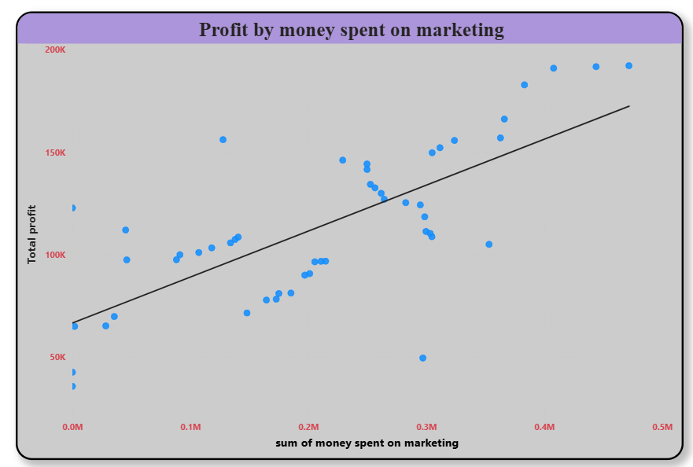
Marketing Spend vs Profit
Sum of Marketing_Spend | Profit
0 | 35673.41
0 | 42559.73
297114.46 | 49490.75
1903.93 | 64926.08
28334.72 | 65200.33
35534.17 | 69758.98
148001.11 | 71498.49
164470.71 | 77798.83
172795.67 | 78239.91
174999.3 | 81005.76
185265.1 | 81229.06
197029.42 | 89949.14
201126.82 | 90708.19
205517.64 | 96479.51
210797.67 | 96712.8
214634.81 | 96778.92
46085.25 | 97427.84
88218.23 | 97483.56
91131.24 | 99937.59
107138.38 | 101004.6
118148.2 | 103282.4
353183.81 | 105008.3
134050.07 | 105733.5
137962.62 | 107404.3
140574.81 | 108552
304768.73 | 108734
303319.26 | 110352.3
299737.29 | 111313
45173.06 | 112012.6
298664.47 | 118474
0 | 122776.9
294919.57 | 124266.9
282574.31 | 125370.4
264346.06 | 126992.9
261776.23 | 129917
256512.92 | 132602.7
252664.93 | 134307.4
249839.44 | 141585.5
249744.55 | 144259.4
229160.95 | 146122
304981.62 | 149760
311613.29 | 152211.8
323876.68 | 155752.6
127716.82 | 156122.5
362861.36 | 156991.1
366168.42 | 166187.9
383199.62 | 182902
407934.54 | 191050.4
443898.53 | 191792.1
471784.1 | 192261.8

Slide 11
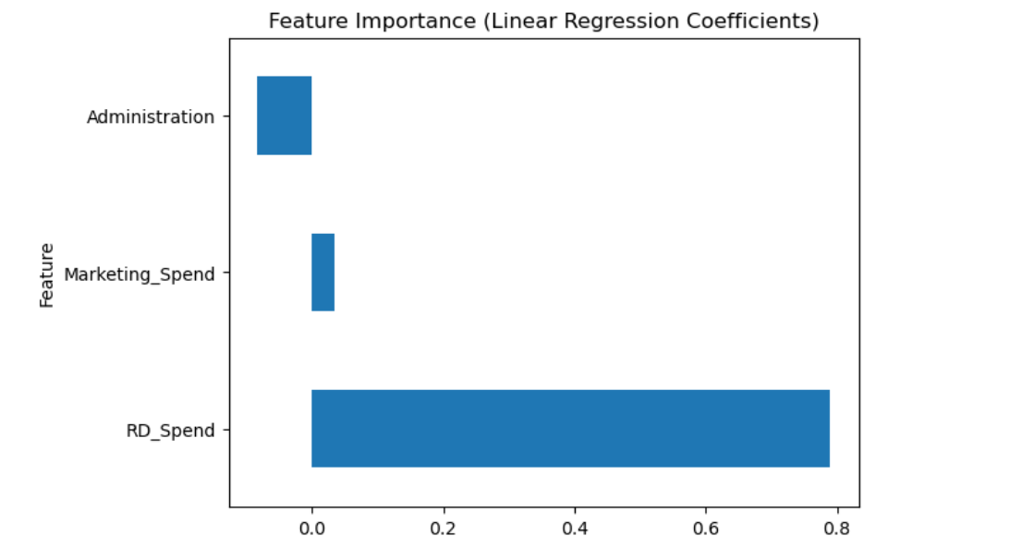
Feature Importance

Slide 12
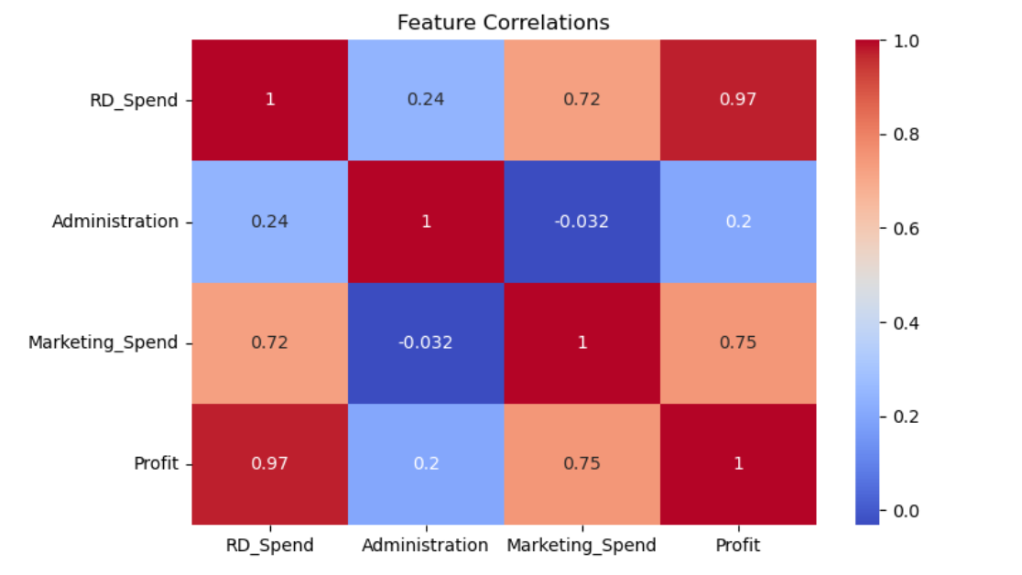
Feature Correlation (Heat Map)

Slide 13
Insights & Findings
R&D Spend is the most critical factor driving Profit.
Marketing Spend contributes but less than R&D.
Administration cost shows very low/insignificant impact.
High R&D + Balanced Marketing leads to maximum profit growth.

Slide 14
Recommendations
Increase allocation towards R&D for innovation & higher profit
Optimize Marketing Spend for better ROI (Return on Investment
Reassess Administrative costs – minimal impact on profit
Use predictive model for future profit forecasting

Slide 15
Conclusion
Regression analysis provided clear insights into profit drivers
Predictions help in budget planning & investment strategies
Data visualization (Tableau/Power BI) enhances decision-making
Future Scope: Add more variables like State, Competitor Analysis, Market Trends

Slide 16
Q&A
Thank You
Open for Questions

